Slide 1
INVEST SMART
BY:
P.KARTHIK(1602-23-737-092)
V.SRAVYA(1602-23-737-118)
M.JITHENDRA SAI (1602-23-737-091)

Slide 2
PROBLEM STATEMENT:
Develop an application that enables users to input and manage their personal financial data, including monthly income, investments,expenses, savings and it will provide expected income at retirement.
MOTIVATION
In today’s fast-paced world, managing personal finances effectively is crucial for long-term financial stability and planning. So we have decided to design this application which is helpful to everyone

Slide 3
ABSTRACT:
→Invest Smart is an application designed to simplify this process for users to manage their income and investment goals. By providing a straightforward graphical interface built with GUI(graphical user interface) library.
→The application will provide visual feedback through graphs to help users better understand their financial situation and plan accordingly.
Overall, this project aims to empower users with a clear and interactive way to manage their finances, ultimately supporting better financial planning and decision-making

Slide 4
TECHNOLOGY
STACK:
PROGRAMMING LANGUAGE:
Python
VISUALIZATION:
MatPlotlib
DATA COLLECTION: Allowing users to enter their income,expenses,savings their investment goals,risk tolerance,and their preferences using numpy or pandas.
GUI FRAMEWORK
Tkinter

Slide 5


HIGH-LEVEL DESIGN
Tkinter Entry Widgets:
calculate_future_income_and_savings() Function:
messagebox.showinfo():
1
2
3
User Input: The user enters data (monthly income, current age, retirement age, expected annual return, monthly contribution) in the
provided fields.
Calculate Expected Income: Upon clicking the "Calculate Expected Income" button, the application retrieves inputs, validates them, and calculates the projected retirement savings and monthly income.
Display Calculation Results: The total retirement amount and projected monthly income are displayed to the user in a message box.
4
5
Generate Graph: When the "Show Financial Overview Graph" button is clicked, the application generates a pie chart to compare monthly income, projected retirement income, and monthly contributions (if calculations are complete).
Error Handling: If inputs are invalid (e.g., retirement age less than current age), the application displays an error message for correction.
try-except Blocks: messagebox.showerror()
show_chart() Function (Matplotlib):

Slide 6
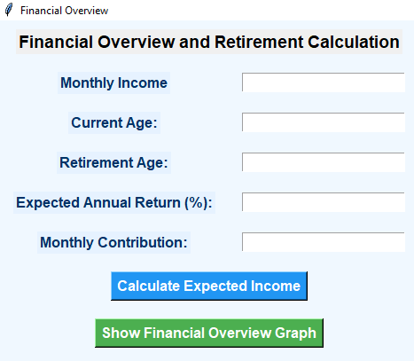
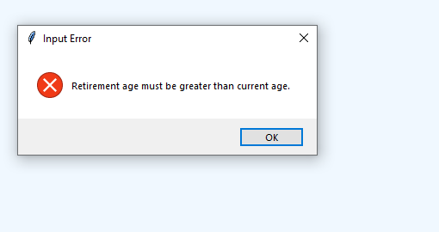
RESOURCE IMPLEMENTATION
1. Tkinter (GUI Framework)
Purpose: Used to create the graphical user interface, allowing users to interact with input fields, buttons, and display elements.
Features:
User input fields for financial data (e.g., Monthly Income, Current Age).
Buttons for triggering calculations and displaying graphs.
Message boxes for outputting results and error messages.

Slide 7
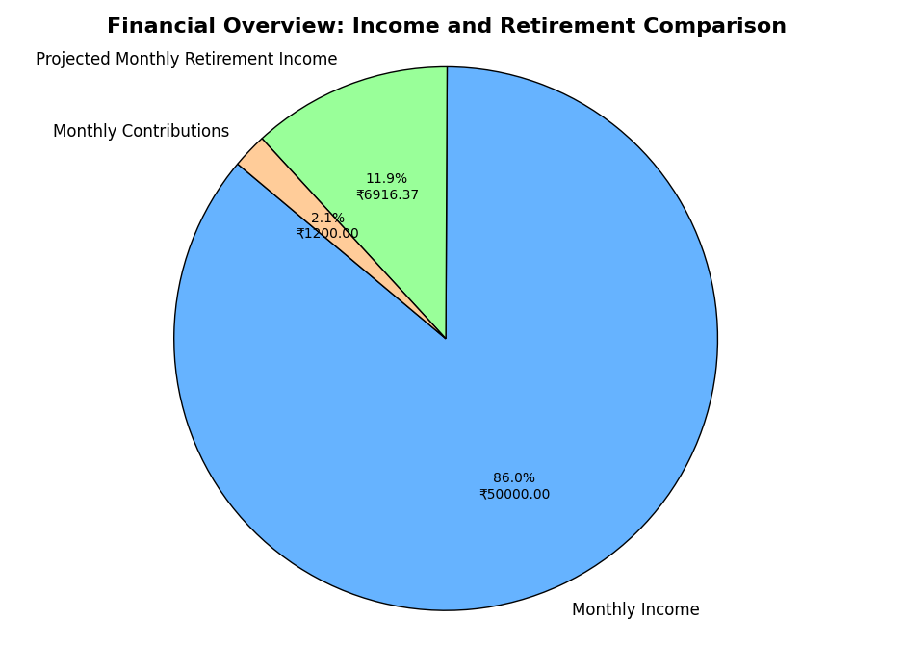
2. Matplotlib (Data Visualization Library)
Purpose: Used to create visual representations of the financial data, such as pie charts and other graphs.
Features:
Generates pie charts for financial comparisons, displaying proportions of Monthly Income, Projected Retirement Income, and Monthly Contributions.
Provides clear visualizations to help users understand their financial breakdown.
Python (Programming Language)
Purpose: The main language for the backend logic, handling data processing,
calculations, and interactions between Tkinter and Matplotlib.
Features:
calculate_future_income(): A function that processes user input and calculates the estimated retirement income.
Data validation and error handling to ensure inputs are logically consistent (e.g., ensuring retirement age > current age).

Slide 8
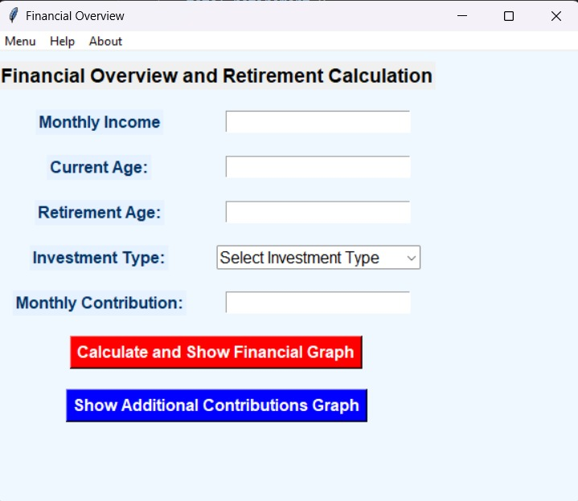
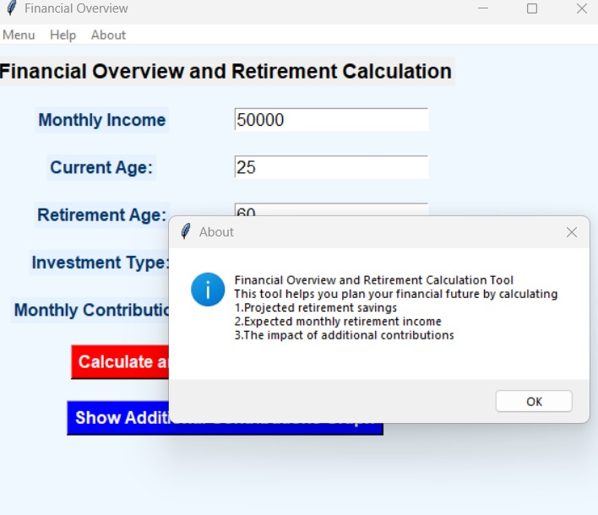
EXCEUTION:

Slide 9
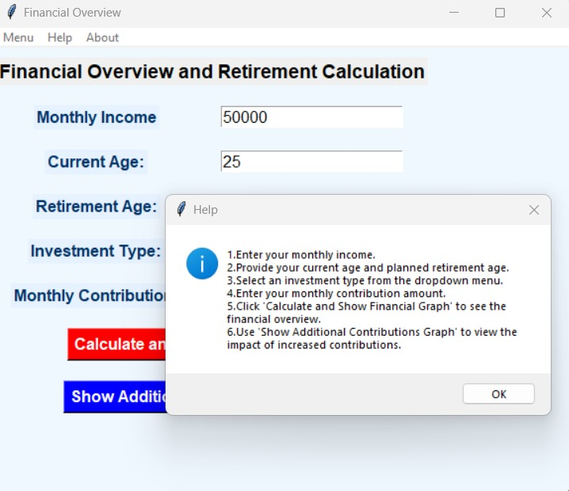
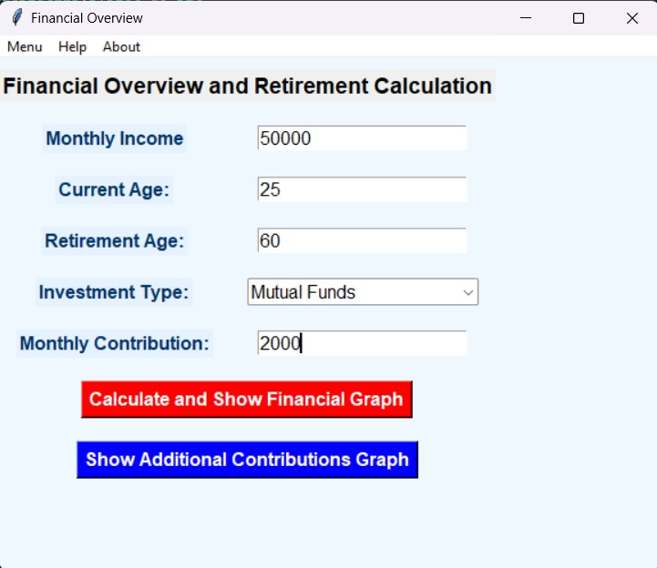

Slide 10
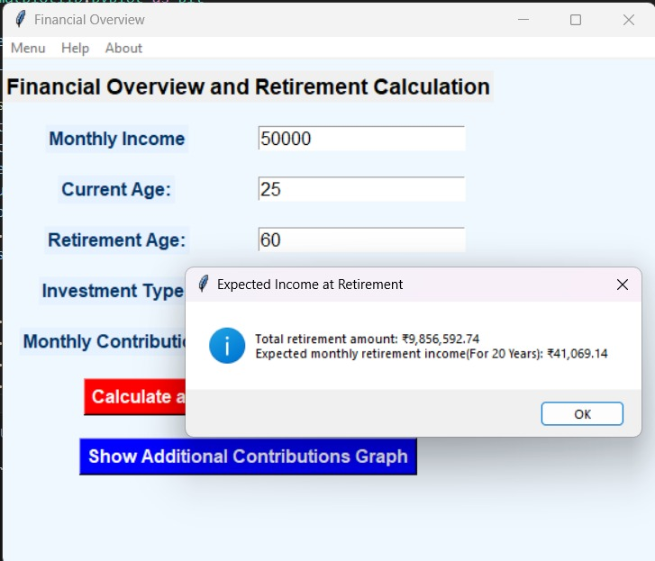
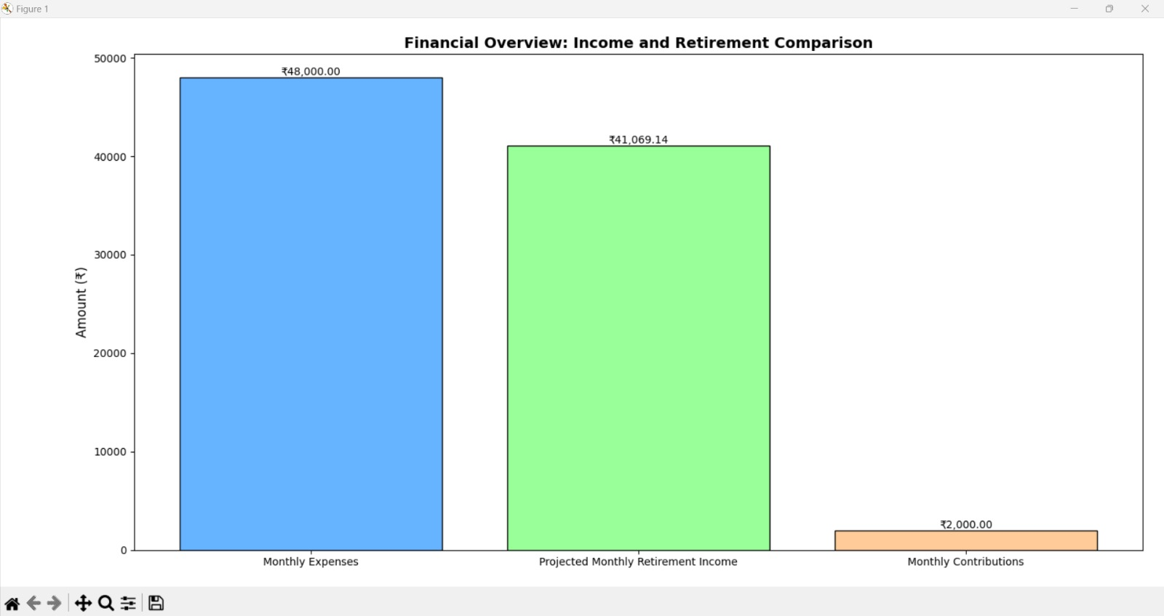

Slide 11
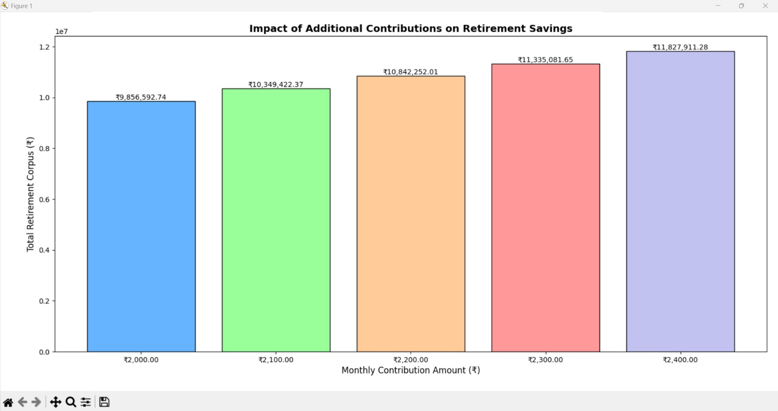
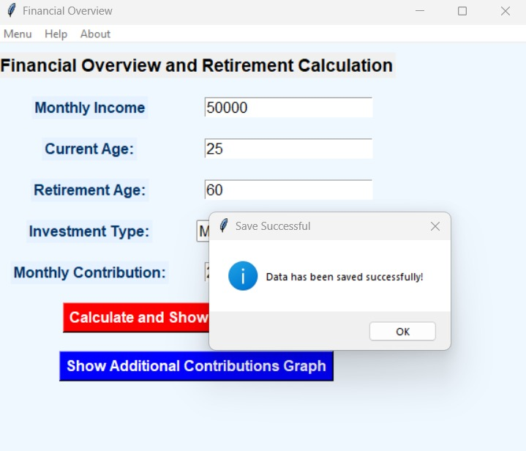

Slide 12
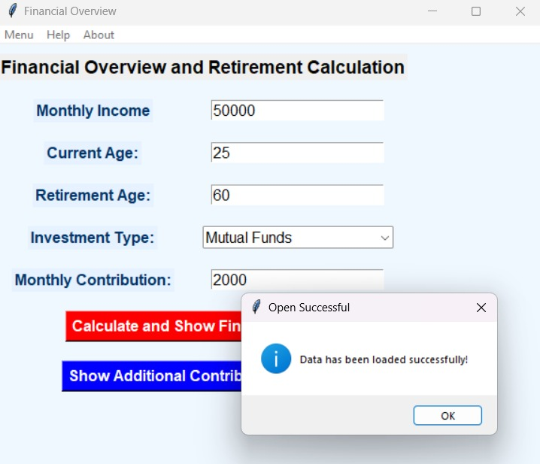
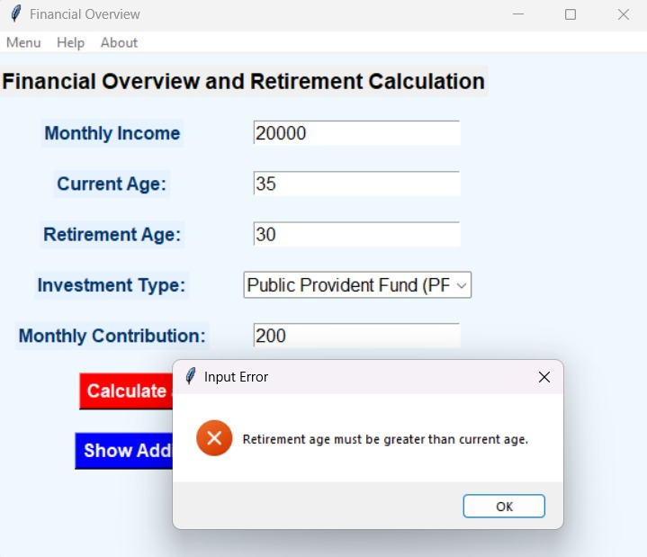

Slide 13
FUTURE WORK
Investment Analysis: Add more investment types (e.g., stocks, bonds, REITs) and detailed metrics like historical returns and risks.
Enhanced UI: Introduce sliders, real-time graphs, and a modern design for better interactivity.
Live Data: Integrate APIs for real-time financial data to improve accuracy.
Security: Add secure logins and data encryption for privacy.
Mobile App: Develop a mobile version using platforms like Kivy or React Native.

Slide 14
CONCLUSION
The project provides a simple yet effective tool for retirement planning, enabling users to visualize their financial future based on different savings and investment strategies. It highlights the importance of disciplined saving and informed investment choices, making financial planning accessible to everyone.

